Slide 1
GPU based OpenGL
Sang Il Park
Dept. of Digital Contents

Slide 2
Programming with OpenGL in a modern way

Slide 3
Changing in OpenGL
Performance is achieved by using GPU rather than CPU
Control GPU through programs called shaders
E. Angel and D. Shreiner: Interactive Computer Graphics 6E © Addison-Wesley 2012

Slide 4
“new” OpenGL
We’ll concentrate on the latest versions of OpenGL
  The currently available version is 4.5
  At least higher than OpenGL 3.0 will work fine with the class
They enforce a new way to program with OpenGL
  Allows more efficient use of GPU resources
modern OpenGL doesn’t support
  Fixed-function graphics operations
    lighting
    transformations
All applications must use shaders for their graphics processing
Notes:
While OpenGL has been around for close to 20 years, a lot of changes have occurred in that time. This course concentrates on the latest versions of OpenGL. In these modern versions of OpenGL (which we defined as versions starting with version 3.1), OpenGL applications are shader based. In fact most of this course will discuss shaders and the operations they support.
If you’re familiar with previous versions of OpenGL, or other rasterization-based graphics pipelines that may have included fixed-function processing, we won’t be covering those techniques since these functions have been deprecated. Instead, we’ll concentrate on showing how we can implement those techniques on a modern, shader-based graphics pipeline.
In this modern world of OpenGL, all applications will need to provide shaders, and as such, providing some perspective on how the pipeline evolved and its phases will be illustrative. We’ll discuss this next.

Slide 5











The Latest Pipelines
Latest version is 4.5 (2014)
Vertex
Data
Vertex
Shader
Primitive
Setup and Rasterization
Fragment
Shader
Blending
Tessellation
Control
Shader
Tessellation
Evaluation
Shader
Geometry
Shader
Pixel
Data
Texture
Store
Notes:
The OpenGL 4.X pipeline added another pair of shaders (which work in tandem, so we consider it a single stage) for supporting dynamic tessellation in the GPU. Tessellation control and tessellation evaluation shaders were added to OpenGL version 4.0.
The current version of OpenGL is 4.3, which includes some additional features over the 4.0 pipeline, but no new shading stages.

Slide 6
OpenGL Libraries
OpenGL core library
  OpenGL32 on Windows
  GL on most unix/linux systems (libGL.a)
OpenGL Utility Library (GLU)
  Provides functionality in OpenGL core but avoids having to rewrite code
  Will only work with legacy code
Links with window system
  GLX for X window systems
  WGL for Windows
  AGL for Macintosh

Slide 7
GLUT
OpenGL Utility Toolkit (GLUT)
  Provides functionality common to all window systems
    Open a window
    Get input from mouse and keyboard
    Menus
    Event-driven
  Code is portable but GLUT lacks the functionality of a good toolkit for a specific platform
    No slide bars
E. Angel and D. Shreiner: Interactive Computer Graphics 6E © Addison-Wesley 2012

Slide 8
freeGLUT
GLUT was created long ago and has been unchanged
  Amazing that it works with OpenGL 3.1
  Some functionality can’t work since it requires deprecated functions
freeglut updates GLUT
  Added capabilities
  Context checking
E. Angel and D. Shreiner: Interactive Computer Graphics 6E © Addison-Wesley 2012

Slide 9
GLEW
OpenGL Extension Wrangler Library
Makes it easy to access OpenGL extensions available on a particular system
Avoids having to have specific entry points in Windows code
Application needs only to include glew.h and run a glewInit()
E. Angel and D. Shreiner: Interactive Computer Graphics 6E © Addison-Wesley 2012

Slide 10
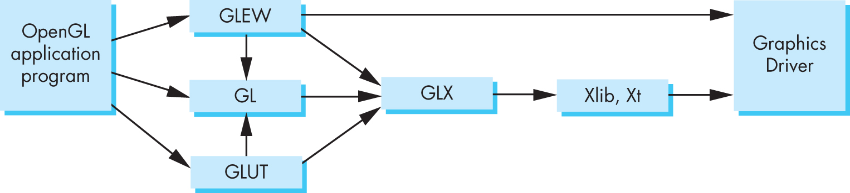
Software Organization
E. Angel and D. Shreiner: Interactive Computer Graphics 6E © Addison-Wesley 2012

Slide 11
Three different drawing approaches: Many points

Slide 12
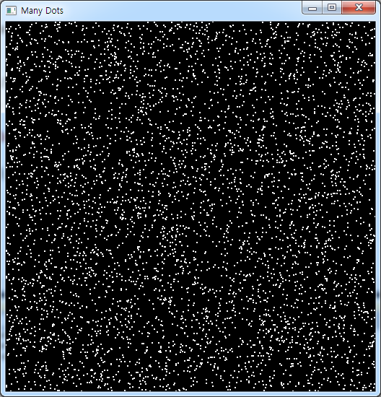
Drawing random dots on the screen

Slide 13
Three approaches
Immediate mode graphics
Retained mode graphics
GPU based graphics

Slide 14
Immediate mode graphics
Generate one primitive at a time and
draw it immediately
void display()
{
for(num_points)
{
p = generate_a_point();
Draw_a_point(p);
}
}

Slide 15
Immediate mode graphics:
#include <vgl.h>
void display()
{
glClear(GL_COLOR_BUFFER_BIT);
glBegin(GL_POINTS);
for(int i=0; i<5000; i++)
{
float x = (rand()%200)/100.0f-1.0f;
float y = (rand()%200)/100.0f-1.0f;
glVertex2f(x,y);
}
glEnd();
glFlush();
}
int main(int argc, char ** argv)
{
glutInit(&argc, argv);
glutInitDisplayMode(GLUT_SINGLE|GLUT_RGBA);
glutInitWindowSize( 512, 512 );
glutCreateWindow("Many Points");
glutDisplayFunc(display);
glutMainLoop();
return 0;
}

Slide 16
Retained mode Graphics
Generate all primitives first,
then draw them all
p[num_points];
void initialize()
{
for(num_points)
{
q = generate_a_point();
p = store_the_point(q);
}
}
void display()
{
draw_all_the_points(p)
}

Slide 17
GPU-based Graphics
Generate all the points first, send them to GPU, and then draw them.
p[num_points];
void initialize()
{
for(num_points)
{
q = generate_a_point();
p = store_the_point(q);
}
Send_all_points_to_GPU(p);
}
void display()
{
display_data_on_GPU();
}
What is different from the previous one?

Slide 18
A First Program:
Many points with GPU

Slide 19

Setting for the most current opengl version for your computer
int main(int argc, char ** argv)
{
glutInit(&argc, argv);
glutInitDisplayMode(GLUT_SINGLE|GLUT_RGBA);
glutInitWindowSize(512,512);
glutCreateWindow("Many Points GPU");
glewExperimental = true;
glewInit();
printf("OpenGL %s, GLSL %s\n",
glGetString(GL_VERSION),
glGetString(GL_SHADING_LANGUAGE_VERSION));
glutDisplayFunc(display);
glutMainLoop();
return 0;
}
For using the
modern OpenGL
To check the
Current version

Slide 20
OpenGL Pipeline (Simplified)
Application
GPU Data Flow
Framebuffer
Vertices
Vertices
Fragments
Pixels
Vertex
Processing
Rasterizer
Fragment Processing
Vertex
Shader
Fragment
Shader
Notes:
To begin, let us introduce a simplified model of the OpenGL pipeline. Generally speaking, data flows from your application through the GPU to generate an image in the frame buffer. Your application will provide vertices, which are collections of data that are composed to form geometric objects, to the OpenGL pipeline. The vertex processing stage uses a vertex shader to process each vertex, doing any computations necessary to determine where in the frame buffer each piece of geometry should go. The other shading stages we mentioned – tessellation and geometry shading – are also used for vertex processing, but we’re trying to keep this simple.
After all the vertices for a piece of geometry are processed, the rasterizer determines which pixels in the frame buffer are affected by the geometry, and for each pixel, the fragment processing stage is employed, where the fragment shader runs to determine the final color of the pixel.
In your OpenGL applications, you’ll usually need to do the following tasks:
specify the vertices for your geometry
load vertex and fragment shaders (and other shaders, if you’re using them as well)
issue your geometry to engage the OpenGL pipeline for processing
Of course, OpenGL is capable of many other operations as well, many of which are outside of the scope of this introductory course. We have included references at the end of the notes for your further research and development.

Slide 21
OpenGL Programming in a Nutshell
Modern OpenGL programs essentially do the following steps:
  Create buffer objects and load data into them
  Create shader programs
  “Connect” data locations with shader variables
  Render
Notes:
You’ll find that a few techniques for programming with modern OpenGL goes a long way. In fact, most programs – in terms of OpenGL activity – are very repetitive. Differences usually occur in how objects are rendered, and that’s mostly handled in your shaders.
There four steps you’ll use for rendering a geometric object are as follows:
First, you’ll load and create OpenGL shader programs from shader source programs you create
Next, you will need to load the data for your objects into OpenGL’s memory. You do this by creating buffer objects and loading data into them.
Continuing, OpenGL needs to be told how to interpret the data in your buffer objects and associate that data with variables that you’ll use in your shaders. We call this shader plumbing.
Finally, with your data initialized and shaders set up, you’ll render your objects
We’ll expand on those steps more through the course, but you’ll find that most applications will merely iterate through those steps.

Slide 22
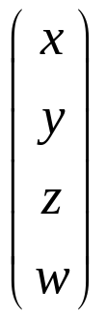
Representing Geometric Objects
Geometric objects are represented using vertices
A vertex is a collection of generic attributes
  positional coordinates
  colors
  texture coordinates
  any other data associated with that point in space
Position stored in 4 dimensional homogeneous coordinates
Vertex data must be stored in vertex buffer objects
(VBOs)
VBOs must be stored in vertex array objects
(VAOs)
Notes:
In OpenGL, as in other graphics libraries, objects in the scene are composed of geometric primitives, which themselves are described by vertices. A vertex in modern OpenGL is a collection of data values associated with a location in space. Those data values might include colors, reflection information for lighting, or additional coordinates for use in texture mapping. Locations can be specified on 2, 3 or 4 dimensions but are stored in 4 dimensional homogeneous coordinates.
Vertices must be organized in OpenGL server-side objects called vertex buffer objects (also known asVBOs), which need to contain all of the vertex information for all of the primitives that you want to draw at one time. VBOs can store vertex information in almost any format (i.e., an array-of-structures (AoS) each containing a single vertex’s information, or a structure-of-arrays (SoA) where all of the same “type” of data for a vertex is stored in a contiguous array, and the structure stores arrays for each attribute that a vertex can have). The data within a VBO needs to be contiguous in memory, but doesn’t need to be tightly packed (i.e., data elements may be separated by any number of bytes, as long as the number of bytes between attributes is consistent).
VBOs are further required to be stored in vertex array objects (known as VAOs). Since it may be the case that numerous VBOs are associated with a single object, VAOs simplify the management of the collection of VBOs.

Slide 23
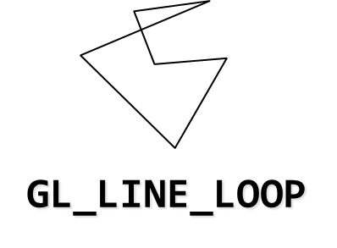
OpenGL’s Geometric Primitives
All primitives are specified by vertices
GL_POINTS
GL_LINES
GL_LINE_STRIP
GL_TRIANGLES
GL_TRIANGLE_FAN
GL_TRIANGLE_STRIP
Notes:
To form 3D geometric objects, you need to decompose them into geometric primitives that OpenGL can draw. OpenGL only knows how to draw three things: points, lines, and triangles, but can use collections of the same type of primitive to optimize rendering.

Slide 24
Creating Data
Define an array for storing all the points
struct vec2
{
float x;
float y;
};
const int NumPoints = 5000;
void init()
{
vec2 points[NumPoints];
for ( int i = 0; i < NumPoints; i++ )
{
points[i].x = (rand()%200)/100.0f-1.0f;
points[i].y = (rand()%200)/100.0f-1.0f;
}
}
Notes:
In OpenGL, as in other graphics libraries, objects in the scene are composed of geometric primitives, which themselves are described by vertices. A vertex in modern OpenGL is a collection of data values associated with a location in space. Those data values might include colors, reflection information for lighting, or additional coordinates for use in texture mapping. Locations can be specified on 2, 3 or 4 dimensions but are stored in 4 dimensional homogeneous coordinates.
Vertices must be organized in OpenGL server-side objects called vertex buffer objects (also known asVBOs), which need to contain all of the vertex information for all of the primitives that you want to draw at one time. VBOs can store vertex information in almost any format (i.e., an array-of-structures (AoS) each containing a single vertex’s information, or a structure-of-arrays (SoA) where all of the same “type” of data for a vertex is stored in a contiguous array, and the structure stores arrays for each attribute that a vertex can have). The data within a VBO needs to be contiguous in memory, but doesn’t need to be tightly packed (i.e., data elements may be separated by any number of bytes, as long as the number of bytes between attributes is consistent).
VBOs are further required to be stored in vertex array objects (known as VAOs). Since it may be the case that numerous VBOs are associated with a single object, VAOs simplify the management of the collection of VBOs.

Slide 25
Draw the array at once
Define an array for storing all the points
void display()
{
glClear(GL_COLOR_BUFFER_BIT);
glDrawArrays(GL_POINTS, 0, NumPoints);
}
Above code draws the data in GPU.
But we didn’t send the data to GPU at all!!
Notes:
In OpenGL, as in other graphics libraries, objects in the scene are composed of geometric primitives, which themselves are described by vertices. A vertex in modern OpenGL is a collection of data values associated with a location in space. Those data values might include colors, reflection information for lighting, or additional coordinates for use in texture mapping. Locations can be specified on 2, 3 or 4 dimensions but are stored in 4 dimensional homogeneous coordinates.
Vertices must be organized in OpenGL server-side objects called vertex buffer objects (also known asVBOs), which need to contain all of the vertex information for all of the primitives that you want to draw at one time. VBOs can store vertex information in almost any format (i.e., an array-of-structures (AoS) each containing a single vertex’s information, or a structure-of-arrays (SoA) where all of the same “type” of data for a vertex is stored in a contiguous array, and the structure stores arrays for each attribute that a vertex can have). The data within a VBO needs to be contiguous in memory, but doesn’t need to be tightly packed (i.e., data elements may be separated by any number of bytes, as long as the number of bytes between attributes is consistent).
VBOs are further required to be stored in vertex array objects (known as VAOs). Since it may be the case that numerous VBOs are associated with a single object, VAOs simplify the management of the collection of VBOs.

Slide 26
How to send your data
Vertex data must be stored in vertex buffer objects
(VBOs)
VBOs must be stored in vertex array objects
(VAOs)

Slide 27
How to send your data
Generate a Vertex Array
glGenVertexArray(..)
Bind the Vertex Array
glBindVertexArray(..)
Generate a Buffer Object
glGenBuffers(..)
Bind the Buffer Object
glBindBuffer(..)
Set the Buffer Object data
glBufferData(..)

Slide 28
Vertex Array Objects (VAOs)
VAOs store the data of a geometric object
Steps in using a VAO
  generate VAO names by calling glGenVertexArrays()
  bind a specific VAO for initialization by calling glBindVertexArray()
  update VBOs associated with this VAO
  bind VAO for use in rendering
This approach allows a single function call to specify all the data for an objects
  previously, you might have needed to make many calls to make all the data current
Notes:
Similarly to VBOs, vertex array objects (VAOs) encapsulate all of the VBO data for an object. This allows much easier switching of data when rendering multiple objects (provided the data’s been set up in multiple VAOs).
The process for initializing a VAO is similar to that of a VBO, except a little less involved.
First, generate a name VAO name by calling glGenVertexArrays()
Next, make the VAO “current” by calling glBindVertexArray(). Similar to what was described for VBOs, you’ll call this every time you want to use or update the VBOs contained within this VAO.

Slide 29
VAOs in Code
// Create a vertex array object
GLuint vao;
glGenVertexArrays(1, &vao);
glBindVertexArray(vao);
Notes:
The above sequence calls shows how to create and bind a VAO. Since all geometric data in OpenGL must be stored in VAOs, you’ll use this code idiom often.

Slide 30
Storing Vertex Attributes
Vertex data must be stored in a VBO, and associated with a VAO
The code-flow is similar to configuring a VAO
  generate VBO names by calling glGenBuffers()
  bind a specific VBO for initialization by calling
  glBindBuffer(GL_ARRAY_BUFFER, …)
  load data into VBO using
  glBufferData(GL_ARRAY_BUFFER, …)
  bind VAO for use in rendering later glBindVertexArray()
Notes:
While we’ve talked a lot about VBOs, we haven’t detailed how one goes about creating them. Vertex buffer objects, like all (memory) objects in OpenGL (as compared to geometric objects) are created in the same way, using the same set of functions. In fact, you’ll see that the pattern of calls we make here are similar to other sequences of calls for doing other OpenGL operations.
In the case of vertex buffer objects, you’ll do the following sequence of function calls:
Generate a buffer’s name by calling glGenBuffers()
Next, you’ll make that buffer the “current” buffer, which means it’s the selected buffer for reading or writing data values by calling glBindBuffer(), with a type of GL_ARRAY_BUFFER. There are different types of buffer objects, with an array buffer being the one used for storing geometric data.
To initialize a buffer, you’ll call glBufferData(), which will copy data from your application into the GPU’s memory. You would do the same operation if you also wanted to update data in the buffer
Finally, when it comes time to render using the data in the buffer, you’ll once again call glBindVertexArray() to make it and its VBOs current again. In fact, if you have multiple objects, each with their own VAO, you’ll likely call glBindVertexArray() once per frame for each object.

Slide 31
VBOs in Code
// Create and initialize a buffer object
GLuint buffer;
glGenBuffers(1, &buffer);
glBindBuffer(GL_ARRAY_BUFFER, buffer);
glBufferData(GL_ARRAY_BUFFER, sizeof(points), points, GL_STATIC_DRAW);
Notes:
The above sequence of calls illustrates generating, binding, and initializing a VBO with data. In this example, we use a technique permitting data to be loaded into two steps, which we need as our data values are in two separate arrays. It’s noteworthy to look at the glBufferData() call; in this call, we basically have OpenGL allocate an array sized to our needs (the combined size of our point and color arrays), but don’t transfer any data with the call, which is specified with the NULL value. This is akin to calling malloc() to create a buffer of uninitialized data. We later load that array with our calls to glBufferSubData(), which allows us to replace a subsection of our array. This technique is also useful if you need to update data inside of a VBO at some point in the execution of your application.

Slide 32
We need shaders before drawing
Application
GPU Data Flow
Framebuffer
Vertices
Vertices
Fragments
Pixels
Vertex
Processing
Rasterizer
Fragment Processing
Vertex
Shader
Fragment
Shader
Notes:
To begin, let us introduce a simplified model of the OpenGL pipeline. Generally speaking, data flows from your application through the GPU to generate an image in the frame buffer. Your application will provide vertices, which are collections of data that are composed to form geometric objects, to the OpenGL pipeline. The vertex processing stage uses a vertex shader to process each vertex, doing any computations necessary to determine where in the frame buffer each piece of geometry should go. The other shading stages we mentioned – tessellation and geometry shading – are also used for vertex processing, but we’re trying to keep this simple.
After all the vertices for a piece of geometry are processed, the rasterizer determines which pixels in the frame buffer are affected by the geometry, and for each pixel, the fragment processing stage is employed, where the fragment shader runs to determine the final color of the pixel.
In your OpenGL applications, you’ll usually need to do the following tasks:
specify the vertices for your geometry
load vertex and fragment shaders (and other shaders, if you’re using them as well)
issue your geometry to engage the OpenGL pipeline for processing
Of course, OpenGL is capable of many other operations as well, many of which are outside of the scope of this introductory course. We have included references at the end of the notes for your further research and development.

Slide 33
Vertex Shader Code (vshader.glsl)
#version 330
in vec4 vPosition;
void main()
{
gl_Position = vPosition;
}
Notes:
The above sequence of calls illustrates generating, binding, and initializing a VBO with data. In this example, we use a technique permitting data to be loaded into two steps, which we need as our data values are in two separate arrays. It’s noteworthy to look at the glBufferData() call; in this call, we basically have OpenGL allocate an array sized to our needs (the combined size of our point and color arrays), but don’t transfer any data with the call, which is specified with the NULL value. This is akin to calling malloc() to create a buffer of uninitialized data. We later load that array with our calls to glBufferSubData(), which allows us to replace a subsection of our array. This technique is also useful if you need to update data inside of a VBO at some point in the execution of your application.

Slide 34
Fragment Shader Code (fshader.glsl)
#version 330
out vec4 fColor;
void main()
{
fColor = vec4(1.0,0.0,0.0,1.0);
}
Notes:
The above sequence of calls illustrates generating, binding, and initializing a VBO with data. In this example, we use a technique permitting data to be loaded into two steps, which we need as our data values are in two separate arrays. It’s noteworthy to look at the glBufferData() call; in this call, we basically have OpenGL allocate an array sized to our needs (the combined size of our point and color arrays), but don’t transfer any data with the call, which is specified with the NULL value. This is akin to calling malloc() to create a buffer of uninitialized data. We later load that array with our calls to glBufferSubData(), which allows us to replace a subsection of our array. This technique is also useful if you need to update data inside of a VBO at some point in the execution of your application.

Slide 35
Loading Shaders
#include <InitShader.h>
// Load and use shaders
GLuint program
= InitShader( "vshader.glsl", "fshader.glsl" );
glUseProgram( program );
glsl : opengl shader language
Those are provided in our homepage.
Notes:
The above sequence of calls illustrates generating, binding, and initializing a VBO with data. In this example, we use a technique permitting data to be loaded into two steps, which we need as our data values are in two separate arrays. It’s noteworthy to look at the glBufferData() call; in this call, we basically have OpenGL allocate an array sized to our needs (the combined size of our point and color arrays), but don’t transfer any data with the call, which is specified with the NULL value. This is akin to calling malloc() to create a buffer of uninitialized data. We later load that array with our calls to glBufferSubData(), which allows us to replace a subsection of our array. This technique is also useful if you need to update data inside of a VBO at some point in the execution of your application.

Slide 36
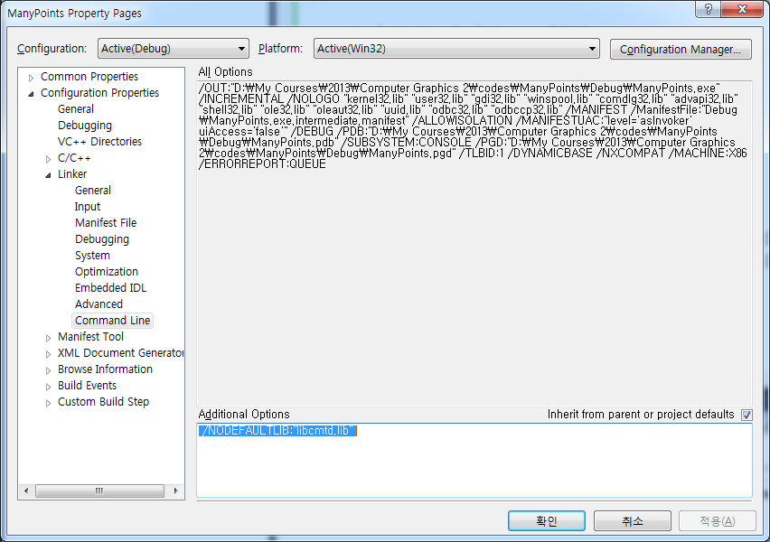
If you see an error:
You should change Project Setting
Conflict with an existing lib “libcmtd.lib”:
/NODEFAULTLIB:"libcmtd.lib"

Slide 37
Connecting Vertex Shaders with Geometry
Application vertex data enters the OpenGL pipeline through the vertex shader
Need to connect vertex data to shader variables
  requires knowing the attribute location
Attribute location can either be queried by calling glGetVertexAttribLocation()
Notes:
The final step in preparing you data for processing by OpenGL (i.e., sending it down for rendering) is to specify which vertex attributes you’d like issued to the graphics pipeline. While this might seem superfluous, it allows you to specify multiple collections of data, and choose which ones you’d like to use at any given time.
Each of the attributes that we enable must be associated with an “in” variable of the currently bound vertex shader. You retrieve vertex attribute locations was retrieved from the compiled shader by calling glGetAttribLocation(). We discuss this call in the shader section.

Slide 38
Vertex Array Code
// set up vertex arrays (after shaders are loaded)
int vPosition = 0;
glEnableVertexAttribArray( vPosition );
glVertexAttribPointer( vPosition, 2, GL_FLOAT, GL_FALSE, 0, BUFFER_OFFSET(0) );
Notes:
To complete the “plumbing” of associating our vertex data with variables in our shader programs, you need to tell OpenGL where in our buffer object to find the vertex data, and which shader variable to pass the data to when we draw. The above code snippet shows that process for our two data sources. In our shaders (which we’ll discuss in a moment), we have two variables: vPosition, and vColor, which we will associate with the data values in our VBOs that we copied form our vertex_positions and vertex_colors arrays.
The calls to glGetAttribLocation() will return a compiler-generated index which we need to use to complete the connection from our data to the shader inputs. We also need to “turn the valve” on our data by enabling its attribute array by calling glEnableVertexAttribArray() with the selected attribute location.
This is the most flexible approach to this process, but depending on your OpenGL version, you may be able to use the layout construct, which allows you to specify the attribute location, as compared to having to retrieve it after compiling and linking your shaders. We’ll discuss that in our shader section later in the course.
BUFFER_OFFSET is a simple macro defined to make the code more readable
#define BUFFER_OFFSET( offset ) ((GLvoid*) (offset))

Slide 39
Drawing Geometric Primitives
For contiguous groups of vertices
Usually invoked in display callback
Initiates vertex shader
glDrawArrays(GL_POINTS, 0, NumPoints);
Notes:
In order to initiate the rendering of primitives, you need to issue a drawing routine. While there are many routines for this in OpenGL, we’ll discuss the most fundamental ones. The simplest routine is glDrawArrays(), to which you specify what type of graphics primitive you want to draw (e.g., here we’re rending a triangle strip), which vertex in the enabled vertex attribute arrays to start with, and how many vertices to send.
This is the simplest way of rendering geometry in OpenGL Version 3.1. You merely need to store you vertex data in sequence, and then glDrawArrays() takes care of the rest. However, in some cases, this won’t be the most memory efficient method of doing things. Many geometric objects share vertices between geometric primitives, and with this method, you need to replicate the data once for each vertex. We’ll see a more flexible, in terms of memory storage and access in the next slides.

Slide 40
Summary
Setting for libraries
  Set include/lib folder
  #include <vgl.h>
  #include <initshader.h>
Creating data (in an array form)
Sending the data
  VAO – vertex array object
  VBO – vertex buffer object
Loading the shaders
Draw it with glDrawArrays(…)
Notes:
In order to initiate the rendering of primitives, you need to issue a drawing routine. While there are many routines for this in OpenGL, we’ll discuss the most fundamental ones. The simplest routine is glDrawArrays(), to which you specify what type of graphics primitive you want to draw (e.g., here we’re rending a triangle strip), which vertex in the enabled vertex attribute arrays to start with, and how many vertices to send.
This is the simplest way of rendering geometry in OpenGL Version 3.1. You merely need to store you vertex data in sequence, and then glDrawArrays() takes care of the rest. However, in some cases, this won’t be the most memory efficient method of doing things. Many geometric objects share vertices between geometric primitives, and with this method, you need to replicate the data once for each vertex. We’ll see a more flexible, in terms of memory storage and access in the next slides.

